Slide 1
ICG Enhanced Fluorescence Guided Laparoscopic Surgery
Dr. A. K. Dhingra

Slide 2
Indocyanine Green Dye - ICG
was developed for near- infrared (NIR) photography by Kodak Research Labs. in 1955 and was introduced in clinical practice in 1956 .
Initially, ICG was used in clinical applications to
measure cardiac output
study the anatomy of retinal vessels – Fluorescein Angiography of Retina
determine liver functional reserve before hepatic resection in cirrhotic livers
Following an i/v Inj., ICG is rapidly bound to pl. protein - then taken up almost exclusively by the Liver cells and is secreted entirely into the bile.

Slide 3
ICG use in Biliary tract
Iatrogenic bile duct injury is still one of the most dangerous complic. of Lap.Chole, with an incid. 0.4 - 1.3 % , generally due to mis-interpretation of biliary tract anatomy .
Careful and meticulous dissection of the Calot’s triangle, achieving the so-called “critical view of safety” and performing perop. cholangiogram, have been demonstrated to keep the incid. of bile ducts injuries as low as possible
Using “virtual” cholangiography at the very start of the procedure, allows the Surgeon to identify the Biliary anatomy & its variations despite the dense inflammation or fibrosis
We are using a high-end full HD camera system IMAGE1 S from Storz that can be operated in dual mode for both white light and fluorescence imaging.

Slide 4
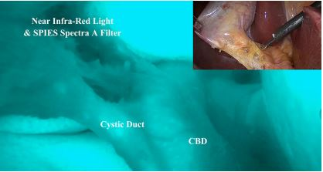
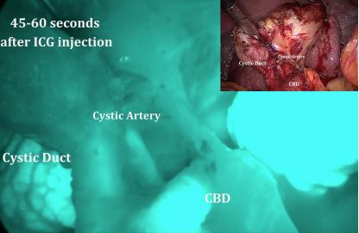
ICG-enhanced Fluorescence-Guided Lap. Chole. Cystic – CBD junction
Use of this technique allows to identify the biliary anatomy in virtually all cases & in particular, the junction between cystic duct and CBD irrespective of the tissue inflammation & fibrosis.
Dose for single image Sequence 1.25 to 5 mg of 2.5 mg/ml soln.
Elective : ICG is given 6-10 hrs prior to the procedure if possible, in any case at least 30 mins before surgery. This ensures most of ICG has accumulated in the extrahepatic duct, with the absence of background fluorescence in the liver
Acute cholecystitis: ICG is given at least 15 mins before the Surgery . In such cases, concomitant background fluorescence is seen in the liver

Slide 5
ICG-enhanced Fluorescence-Guided Lap. Chole. Cystic artery
If d/t difficult anatomy cystic artery visualization is reqd, a small bolus can be injected after a waiting period of 15 min from the first injection
Fluorescence usually develops at the level of Calot’s area delineating the cystic artery after 60 secs. and lasts for approx. 35 secs

Slide 6
ICG-enhanced Fluorescence-Guided Ureter Visualisation in Lap. Pelvic Surgery
ICG is injected through the ureteral catheter, of which only the tip is inserted into the ureteral orifice
May be done in cases of Tumors of -
Uterus, Cervix ,
Colorectal cancers

Slide 7
ICG-Fluorescence Imaging for Vascular Mapping and Assessment
“Angiographic” properties of ICG-enhanced fluorescence is used to facilitate vascular dissection, esp. with anatomical variations
Nephrectomy – Partial or Total
Splenectomy
Liver resection
Vascular surgery.
In these cases, ICG provides a real-time Angiogram pattern of vascularity.

Slide 8
Intraop. Assessment of Lymphatic Drainage and Sentinel Lymph Node Detection
Breast Cancer
Malig. Melanoma
GIT cancer
Uterine & Cervical Cancer
Dye is injected 10–15 min. prior to the procedure, in the peritumoral area or in the scar region if there is h/o prior tumor removal .

Slide 9
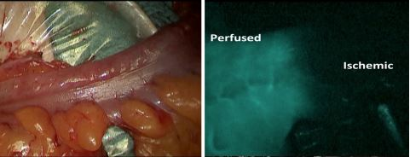
ICG-Enhanced Fluorescence-Guided Colorectal Resection
ICG is injected in two boluses.
1st bolus - after mesenteric division facilitating resection by demarcating well-perfused areas from Ischemic areas .
2nd bolus - prior to bowel anastomosis to confirm adequate perfusion.

Slide 10
ICG fluorescence in Peritoneal mets.
There is a good intraoperative visibility of peritoneal metastases in cases of liver, colorectal and ovarian cancer with ICG

Slide 11
THANKS

