Slide 1
COMPLICATIONS OF LAPAROSCOPIC SURGERY
DR ANIL DHINGRA

Slide 2
INTRODUCTION
Laparoscopic surgeries are currently being increasingly used for wider and wider application.
•
•
It is necessary to have a knowledge of its equipments, basic procedures, limitations and indications & complications.

Slide 3
HISTORY
•
•
•
Celioscopy Peritoneoscopy Laparoscopy

Slide 4
HISTORY
1901
Kelling
1st laparoscopic examination of
abdominal cavity in rats called it celioscopy
1911
Jacobeus
1st human laproscopy
1938 | Veress | Spring loaded obturator needle for
 |  | pneumoperitoneum
1960 | Hopkins | Developed Rod Lens Optical System
1960- | Semm | Developed automatic insufflators and
70
instruments 1st lap appendisectomy. Father of modern laproscopic surgery
1987
Philip Mouret
1st L.C.

Slide 5
EQUIPMENT & INSTRUMENTATION
•
OPTICAL INSTRUMENTS
•
ABDOMINAL ACCESS INSTRUMENTS
•
LAPAROSCOPIC INSTRUMENTS

Slide 6
OPTICAL INSTRUMENTS
- ROD LENS SYSTEM
- FIBER OPTIC CABLES III - LIGHT SOURCES

Slide 7
LAPAROSCOPIC INSTRUMENTS
These are miniature transformation of the instruments used in open surgeries.
Aspirator
Dissecting forceps
Grasping instruments
Scissors
Clip applicator s
Staples
Sutures / needles
Needle holder
Cautery (mono & bi polar)

Slide 8
ABDOMINAL ACCESS INSTRUMENTS
Open Technique Hasson Cannula
Closed Technique Veress Needle Trocar Sheath assemblies

Slide 9
COMPLICATIONS OF LAPAROSCOPICA SURGERIES
Anaesthetics Complications
Complications due to pneumoperitonium
Surgical complications
Diathermy related injuries
Patients factors related complications
Post operative complications

Slide 10
COMPLICATIONS
Anaesthetic Complications :
2. Inadequate Muscle Relaxation –
Contraction of muscle during procedure
Difficulty in Pneumoperitoneum
Causes pain during port
insertion
Management –
-
-
-
Endotracheal intubation
Pharmacological neuromuscular blockade Positive pressure ventilation

Slide 11
Anaesthetic Complications :
2. Mask hyper ventilation
Prior to induction 100% oxygen is given by mask ventilation
Hyperventilation Distended stomach
Respiratory Dysfunction
Liable to injury during port inser. Or
veress needle inser.
Management –
- Nasogastric tube prior to surgery.

Slide 12
Anaesthetic Complications :
3. Air Embolism
CO₂ used for pneumoperitonium
Gets absorbed into circulation Embolus may form and block pulmonary
circulation
Loud and clear murmur heard in (R) atrium and
(R) ventricle (Mill-Wheel murmur)
Management –
Direct intracardiac insertion of needle
Central venous catheter.

Slide 13
Management
-
-
Continuous I/V assess
Emergency cart with all resuscitative drugs and defibrillator.
One should be prepared with –
-
-
-
-
Oxygen Suction
Bag and mask ventilation
Oral and nasal pharyngeal airway, ET tubes of various sizes.
Sphygmomanometer Electrocardiograph Pulse oxymeter
-
-
-

Slide 14
COMPLICATIONS DUE TO PNEUMOPERITONIUM
CO₂ pneumoperitonium
(c) Gas specific effects (b) Pressure Specific Effects
Respiratory Acidosis Excessive Pressure on IVC
Hypercarbia
Reduced VR
Reduced CO
Management -
De^{p}s^{e}u^{r}f^{i}f^{t}lºa^{n}ti^{e}oªn^{l}of abd.
Vagolytic (Atropine)
Adequate volume replacement
Rapid stretch of
membrane
Vasovagal response
Bradycardia, occasionally hypotension

Slide 15
Respiratory Dysfunction
Increased pressure pneumoperitonium
Transmitted directly across paralysed diaphragm to
thoracic cavity
Increase Central venous pressure & inc. filling pressure of (Rt) and (Lt) sides of heart
Management :
Keep intraabdominal pressure under 15 mm Hg

Slide 16
DVT, Pulmonary Embolism
Increased intraabdominal pressure
Reduced VR (Along with reverse Trendlenburg position)
Venous engorgement Deep vein thrombosis
Pulmonary Embolism
Management :
•
•
Sequential compression stockings Subcutaneous heparin or low molecular weight heparin

Slide 17
Effects on renal system
Increased intraabdominal pressure
Reduced RBF, Reduced GFR Inc. ADH activity Reduced Urine output Inc. free water absor.
Inc. plasma renin activity Inc. Na+ retention
Management :
Adequate volume replacement at maintenance rate.

Slide 18
Pneumothorax
Due to true diaphragmatic hernia.
Without any apparent cause. Diagnosis -
Presence of rapidly falling Oxygen saturation or PO2 together with difficult ventilation and decreased breath sounds.
Management –
Immediate needle thoracostomy.
Aspiration
Chest radiograph
Placement of chest tube

Slide 19
Subcutaneous and Subfascial Emphysema and Edema
Improper insertion of veress needle
Manipulation of instruments often loosens the parietal perotoneum surrounding the instruments portal of
exit into the peritoneal cavity.
CO₂ then infiltrates the loose areolar tissue of the body Subsutaneous and subfascial emphysema
* It rapidly resolves within 2 – 4 hours postoperatively.

Slide 20
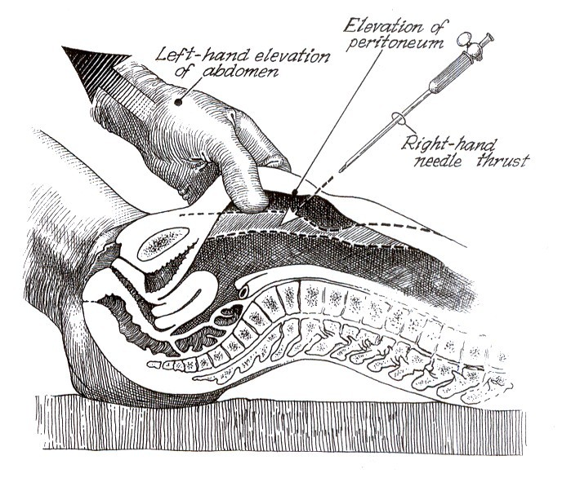

Slide 21
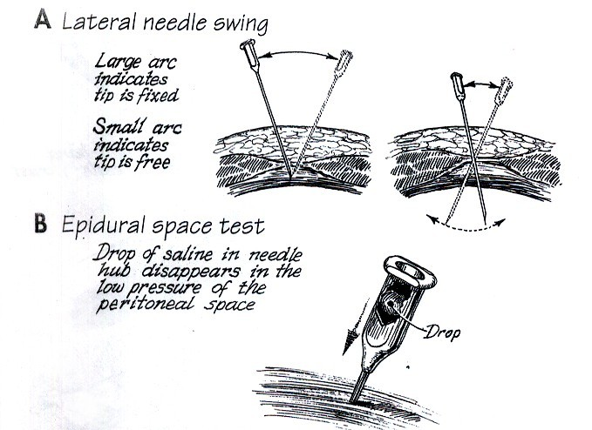
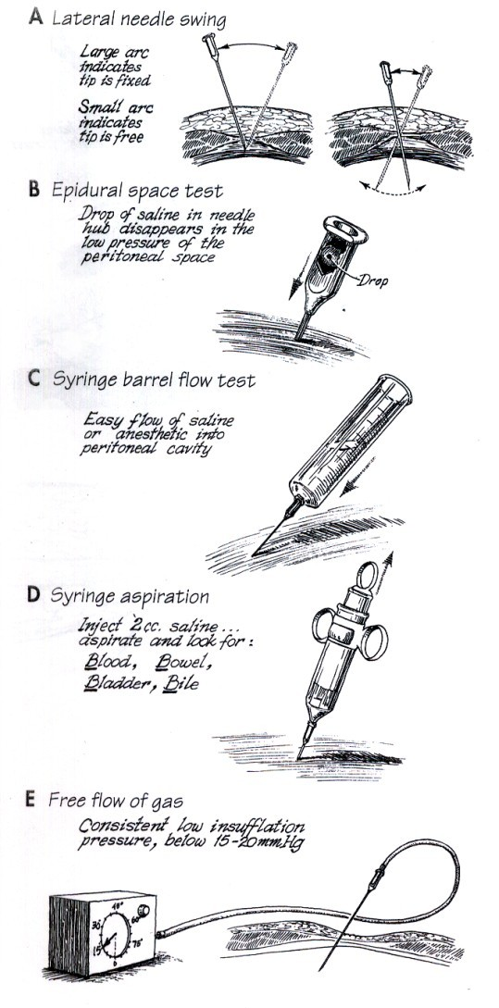

Slide 22
SURGICAL COMPLICATIONS
Injury to Viscus :
Stomach -Hyperventilation by Mask
Distended stomach
May be injured with trochar or needle Diagnosis -
Laparoscopic view of inside of stomach Management –
Extend trocar incision into a minilap. for a two layer closure.
Laparosocpically
  Pursestring suture or a figure of 8 suture in the seromuscular layer surround the defect.
  Nasogastric tube drainage for two days.

Slide 23
Injury to Viscus :
Bowel - May be injured due to trocar or veress needle
If due to veress needle it is managed conservatively Diagnosis -
The emanation of foul smelling gas through pneumo-peritoneal needle is a helpful diagnostic sign.
There may be GI contents at the tip of needle.
Management –
Mini laprotomy and repair of perforation.
Laparoscopically it may be sutured of laparoscopic stapler (ENDO-GIA) can be used.
Colostomy

Slide 24
Injury to Viscus :
Small Bowel Perforation - Most often during insertion of umblical or lower quadrant trocars
Usually recognized later in the procedure
If adhesions are not freed from anterior abdominal wall perforation may not be recognized
Management –
One should consider higher primary site if adhesions are found through umblical port.
Perforation repaired transversally
If injury is free of adhesions bowel can be withdrawn through 10 mm trocar tract and repaired.

Slide 25
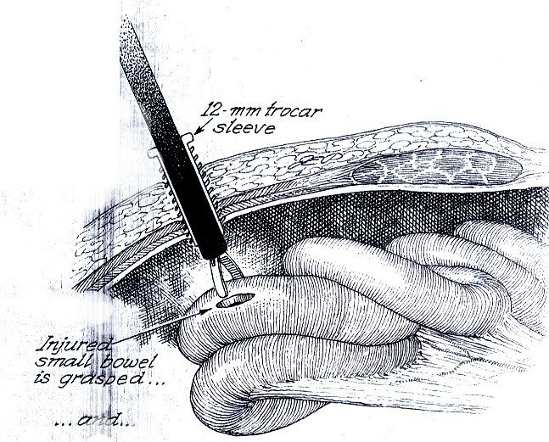
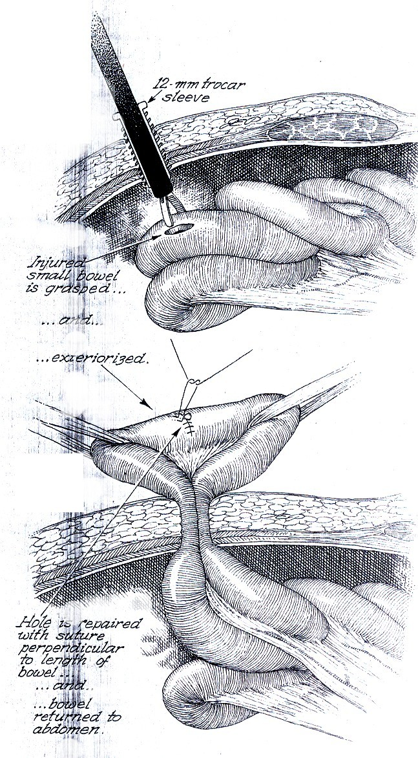

Slide 26
Injury to Viscus :
Bladder - Injury caused by second puncture trocar usually .
Diagnosis : Appearance of gas and blood in Foley’s catheter bag.
Management –
Early detection is important.
Place an indwelling catheter for 7-10 days and prophylactic antibiotics - If defect is larger.
Repaired by a figure of 8 suture through muscularis of bladder & second suture to close peritonium
* A water tight seal should be documented by filling bladder with indigo carmine dye solution.

Slide 27
Injury to Viscus :
Ureter - May be injured in adenexal surgeries.
Thermal injury will result in ureteral narrowing and hydroureter.
Management –
Placement of ureteric stent for 3 – 6 weeks.
Incision Hernia :
Failure to close facial defects from incisions for secondary trocars.
Incised fascia should be located with help of skin hooks and repaired.

Slide 28
Vessel Injury :
Larger vessels may be injured by trocar or veress needle.
CO₂ peritoneum may tamponade a large vessel
injury.
When pressure normalizes it starts bleeding. Management –
Examine the course of large vessels.
Overlying peritoneum is opened with laproscopic scissors or a CO₂ laser.
Hematoma evacuated by alternate suction and irrigation.
* Laprotomy is required if hematoma is expanding or persistent bleeding.

Slide 29
Vessel Injury :
Epigastric Vessels –
Deep epigastric vessels most frequently injured in laproscopic hysterectomy.
Management – By Tamponade –
Rotate second puncture sleave by 360⁰.
By Foley’s catheter
Bipolar coutery
Needle suturing
Small haemostate (Mosquito clamp)
Ovarian or uterine vessels –
Injured during laproscopic hysterectomy Management –
Bipolar desiccation
Ureter must be identified before desiccation.

Slide 30
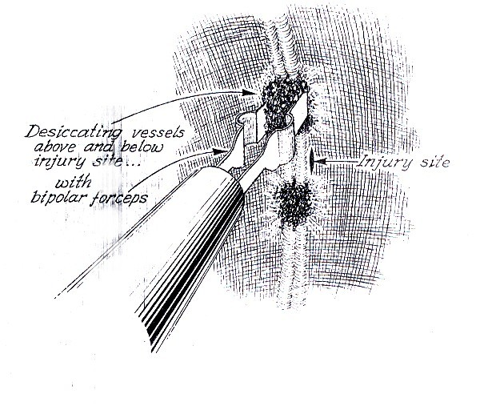

Slide 31
DIATHERMY RELATED INJURIES
Due to –
Inadvertent activation of the diathermy pedal.
Faulty insulation
Direct coupling
Capacitative coupling
Cautery should be used under vision Injuries –
•
•
•
Thermal necrosis of organs. Inadvertent organ ligation.
Unrecognized haemorrhage.

Slide 32
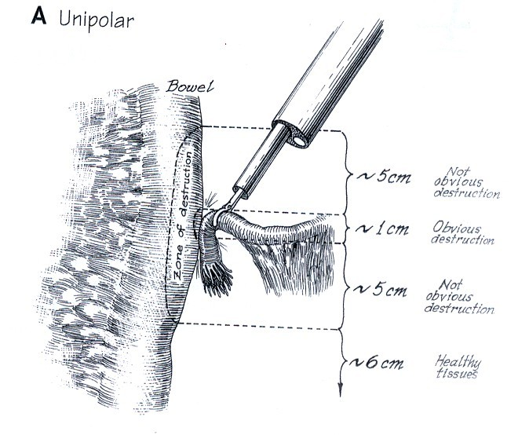
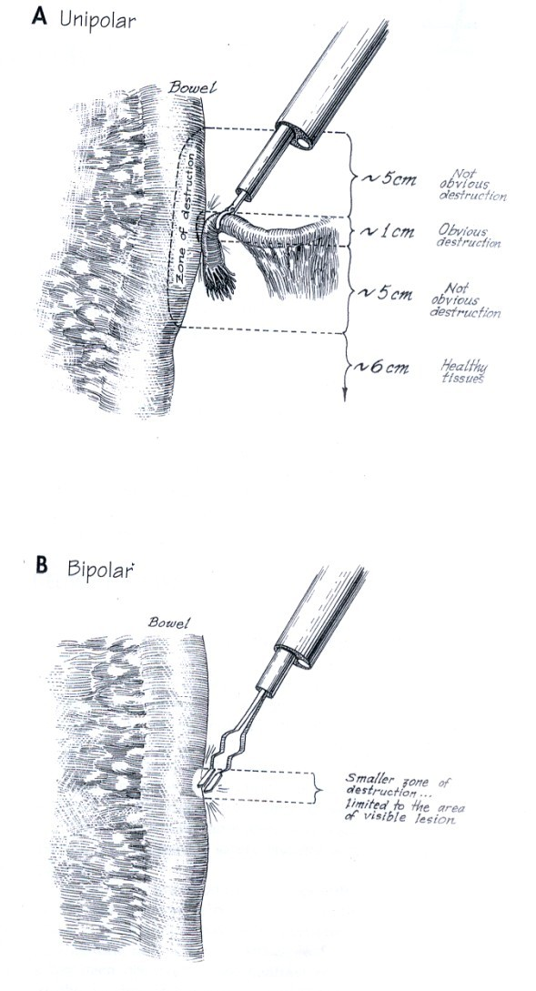

Slide 33
PATIENT’S FACTORS RELATED COMPLICATIONS
•
•
•
•
Obesity Ascites
Organomegaly – organ damage Clotting problems – haemorrhage
POST OPERATIVE COMPLICATIONS
•
•
•
•
Concealed injury to organs Delayed fecal fistula
Port site metastasis
Recidual air (Referred chest or shoulder pain)

Slide 34
CONTRAINDICATIONS
Absolute :
•
•
•
•
•
•
Generalized peritonitis Intestinal obstruction Clotting abnormalities Liver cirrhosis
Failure to tolerate general anesthesia Uncontrolled shock
Relative :
•
•
•
Multiple abdominal adhesions Organomegaly
Abdominal aortic aneurysm

Slide 35
COMPLICATIONS OF LAPROSCOPIC APPENDICECTOMY
Bleeding :
  Inferior epigastric artery
  Appendicular artery
  Retroperitoneal vessels
Perforation of the bowel
  By trocar
  Inadvertent electrosurgical injury
  slippage of appendix base loops
Injury to bladder
Postoperative intraabdominal and pelvic abscess.
Wound infections
Incomplete appendecectomy
Incisional hernia
DVT and pulmonary embolism

Slide 36
COMPLICATIONS OF LAPAROSCOPIC CHOLECYSTECTOMY
Bile Leak :
  Recognized by presence of bile in the drain bottle.
  Patient returns after 3-5 days with pain and tenderness in the right upper quadrant of the abdomen and jaundice
  May arise from cystic duct stump divided cystohepatic duct of Luschka, injury to a major bile duct.
Diagnosis –
by USG or CT by early ERCP
Temporary biliary stent inserted
Management -
endoscopically decompresses the biliary system

Slide 37
Major Bile Duct Injury :
  Incidence is 1 in 300-500 laproscopies.
  It includes complete transaction and clipping of common duct.
Diagnosis – by early ERCP
Management -
* Management of major bile complex and best dealt specializing in their treatment.
duct injuries is with in a unite

Slide 38
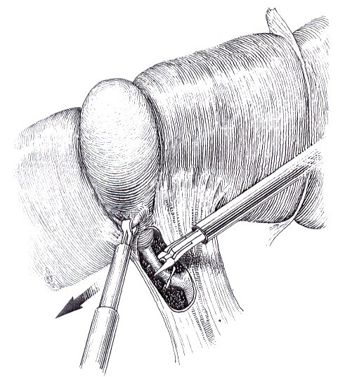

Slide 39
COMPLICATIONS OF LAPAROSCOPIC COLECTOMY
Bowel Injuries :
  The viscra and small bowel including the duodenum, may be damaged by grasping or cauterizing instruments.
  Spleenic injury
  Minimize this by using open insertion of first cannula and subsequent cannula insertion under vision.
5. Vessel Injuries :
- Mesenteric vessels, iliac vessels, epigastric vessels and innominate vessels.
Injury to Ureter
Post operative bleeding
Port site metastasis

Slide 40



